Slide 1
Chapter 2 NATIONAL INCOME ACCOUNTING

Slide 2
Three Approaches of Calculating GDP
Value-Added/Output/Product Approach
Expenditure Approach
Income Approach

Slide 3
Value-Added Approach
This method consists of three stages:
Estimating the gross value of output
Determining the intermediate consumption
Deducting intermediate consumption from gross value to obtain the net value of domestic output.
Gross value of output = Value of the total sales of goods and services + Value of changes in the inventories.

Slide 4
Example
There are three firms in an economy: X, Y, and Z. Firm X buys $200 worth of goods from Y, and $300 worth of goods from firm Z, and produces 250 units of output at $4 per unit. Firm Y buys $150 worth of goods from firm X, and $250 worth of goods from firm Z, and produces 300 units of output at $6 per unit. Firm Z buys $75 worth of goods from firm X, and $50 worth of goods from firm Y, and produces 500 units at $2 per unit. Given this information, what is the economy’s GDP?

Slide 5
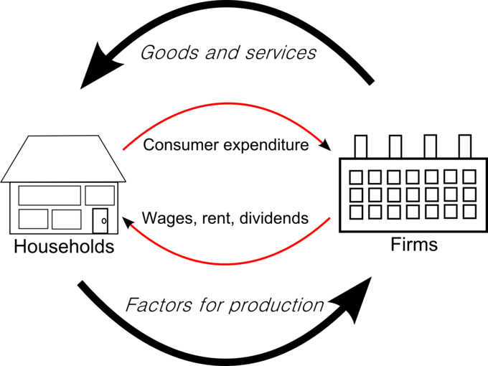

Slide 6
Expenditure Approach
The expenditure approach attempts to calculate GDP by evaluating the sum of all final good and services purchased in an economy.
The most well known approach to calculating GDP, the expenditures approach is characterized by the following formula:
GDP = C + I + G + (X-M)

Slide 7
Income Approach
The income approach measures economic activity by adding all income received by producers of output, including wages received by workers and profits received by owners of the firms.

Slide 8
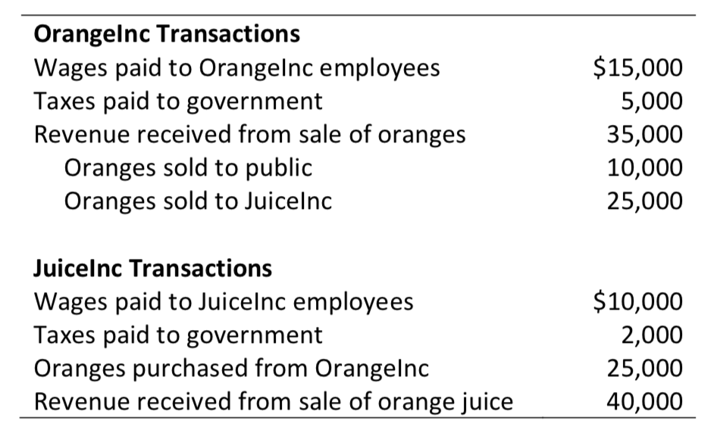
Class Activity
What is the total value, measured in dollars, of the economic activity generated by these two businesses?
Hint: The value added approach, income approach, and expenditure approach all yield the same answer.

Slide 9
National Income (NI)
Sum of a nation's gross domestic product and the net income it receives from overseas.
Also referred to as factor income.

Slide 10
Income Earned by: | GDP | GNP | GNI
Residents in Country | Includes | Includes | Includes
Foreigners in Country | Includes | Excludes All | Includes If Spent in Country
Residents Out of Country | Excludes | Includes All | Includes If Remitted Back
Foreigners Out of Country | Excludes | Excludes | Excludes

Slide 11
Difference between National Income and Personal Income
Personal Income is the sum of all the incomes received by all the individuals or household during a given period.
National income is the income generated by factors of production. But personal income is the income received by factors of production.
01
Income of the government sector is included in the national income but not included in personal income.
02

Slide 12

Inflation & Prices
Inflation is the rate of change in prices, and the price level is the cumulation of past inflations.
Inflation (∏) ≡ (P_{t} – P_{t-1})/ P_{t-1}
where P_{t} is today’s price level & P_{t-1} is last year’s price level.

Slide 13
The Costs of Inflation
Inflation fallacy
“Inflation robs people of the purchasing power of his hard-earned dollars”
When prices rise
Buyers pay more
Sellers get more
Inflation does not in itself reduce people’s real purchasing power

Slide 14
The Costs of Inflation
Shoeleather costs
Resources wasted when inflation encourages people to reduce their money holdings
Inflation discourages saving
Can be substantial
Menu costs
Costs of changing prices
Inflation – increases menu costs that firms must bear

Slide 15

Relative-Price Variability
Market economies
Relative prices allocate scarce resources
Consumers compare quality and prices of various goods and services
Determine allocation of scarce factors of production
Inflation distorts relative prices
Consumer decisions are distorted
Markets are less able to allocate resources to their best use

Slide 16
Deflation May Be Worse
Costs of deflation
Menu costs
Relative-price variability
If not steady and predictable, it can discourage production

Slide 17
Price Index
A normalized average (typically a weighted average) of price relatives for a given class of goods or services in a given region, during a given interval of time.
A statistic designed to help to compare how these prices differ between time periods or geographical locations.

Slide 18
Notable Price Indices
GDP Deflator
Consumer Price Index (CPI)
Producer Price Index (PPI)

Slide 19

GDP Deflator
A very important measure of inflation.
Also called implicit price deflator.
GDP Deflator = $\frac{Nominal GDP}{Real GDP}$ * 100

Slide 20
GDP Deflator
Measures the change in prices between the base year and the current year
Ex. If NGDP in 2015 is $6.25 and RGDP in 2015 is $3.50, then the GDP deflator for 2015 is $6.25/$3.50 = 1.79 → prices have increased by 79% since the base year

Slide 21
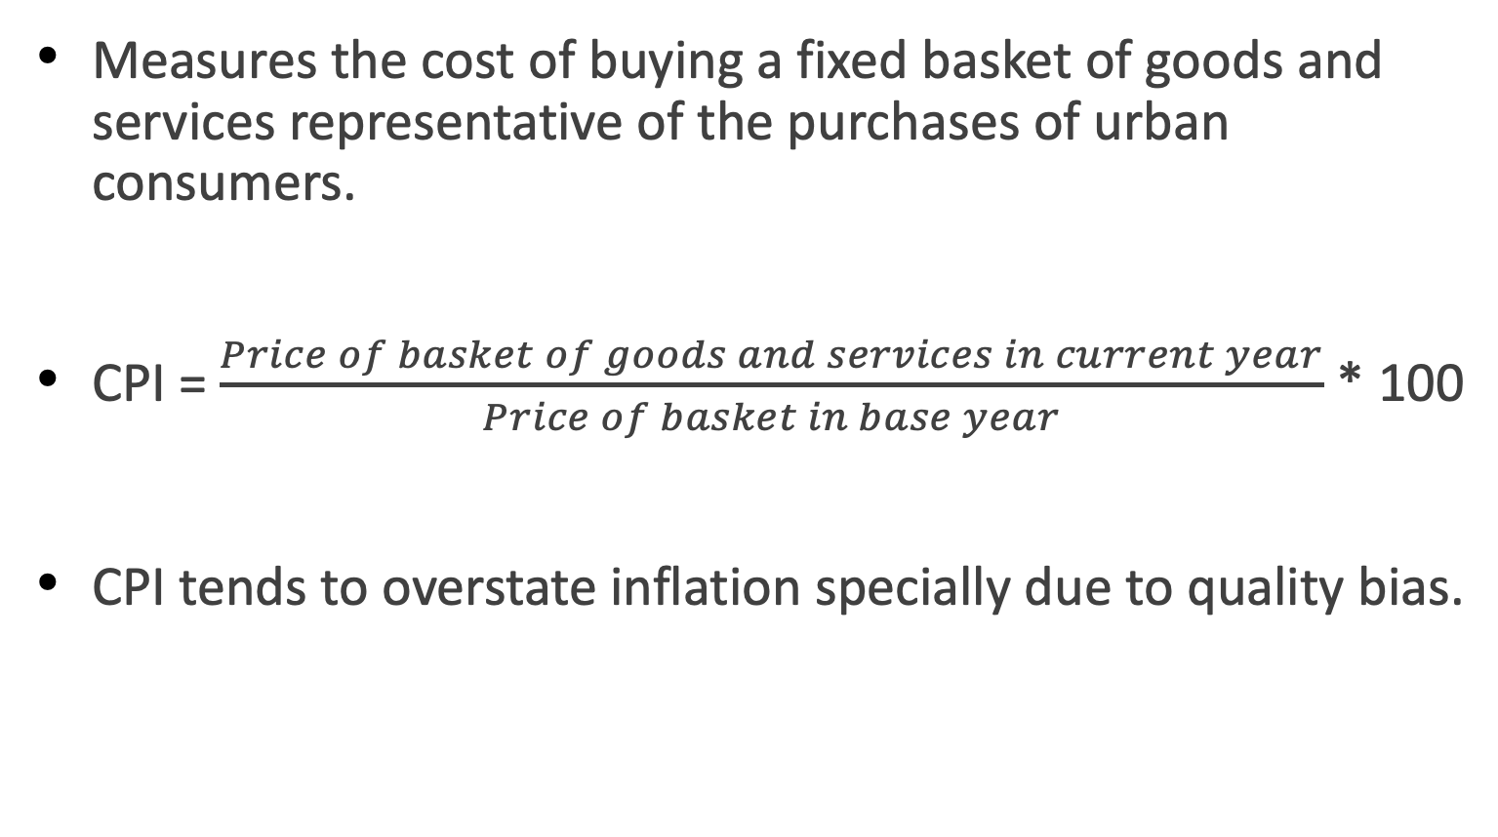
Consumer Price Index (CPI)
Measures the cost of buying a fixed basket of goods and services representative of the purchases of urban consumers.
CPI = $\frac{Price of basket of goods and services in current year}{Price of basket in base year}$ * 100
CPI tends to overstate inflation specially due to quality bias.

Slide 22
Differences between GDP Deflator & CPI?
The deflator measures the prices of a much wider group of goods than the CPI does.
CPI measures the cost of a given basket of goods, which is the same from year to year, unlike GDP deflator, where the basket of goods differs every year, depending on what is produced in the economy.
CPI includes prices of imports, whereas the GDP deflator does not.
Example: If price of Boeing 747 increases???

Slide 23
Producer Price index: PPI
PPI measures the cost of buying a fixed basket of goods and services representative of a firm.
Market basket includes raw materials and semi-finished goods.
PPI is constructed from prices at an earlier stage of the distribution process than the CPI.
PPI signals changes to come in the CPI and is thus closely watched by policymakers.
Over long periods of time, the two measures yield similar values and trends for inflation

Slide 24
Interest Rates & Real Interest Rates
States the rate of payment on a loan or other investment, over and above principal repayment, in terms of an annual percentage.
Real Interest Rate: The rate of interest an investor, saver or lender receives (or expects to receive) after allowing for inflation.
Nominal Interest Rate: Refers to the interest rate before taking inflation into account

Slide 25
Fischer Equation
Real Interest Rate = Nominal Interest Rate - Inflation rate
* R (or i) is the nominal rate and r is the real rate

Slide 26
Unemployment
The unemployment rate measures the fraction of the workforce that is out of work and looking for a job or expecting a recall from a layoff.
Important indicator of well-being of an economy/households.
Optimal unemployment rates differ from country to country.
Optimal unemployment rate linked to the potential level of output for a given economy.

Slide 27
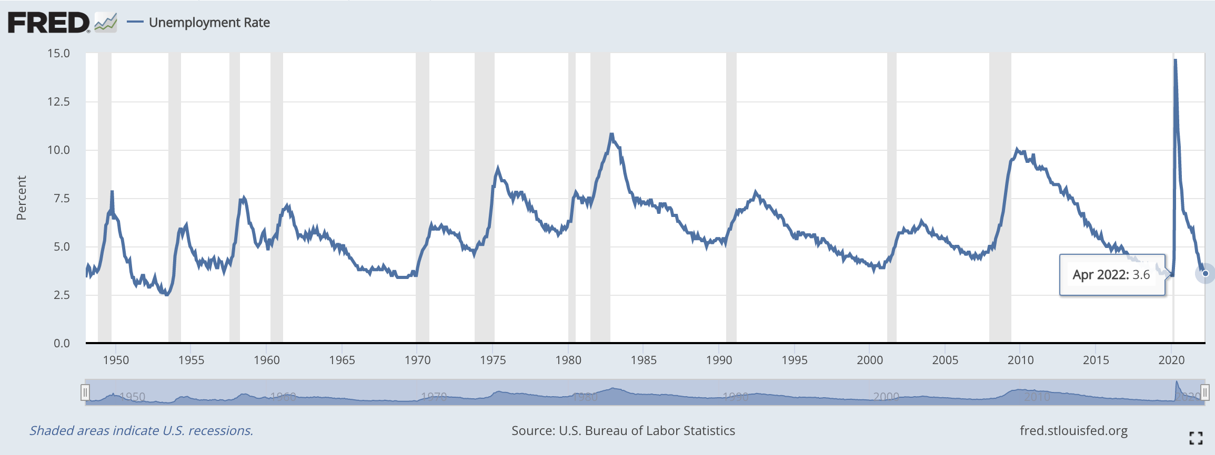
Unemployment

Slide 28
Class Activity
The country of Wakanda produces two goods: Vibranium suits and Slash claws. Below is a table showing prices and quantities of output for 3 years.
Calculate nominal GDP, real GDP and the GDP deflator for each year, using Year 1 as the base year.
What is the inflation rate in year 3 comparing to year 2?
Year | Price of Vibranium Suits | Quantity of Vibranium Suits | Price of Slash claws | Quantity of Slash claws
Year 1 | $10 | 120 | $12 | 200
Year 2 | 12 | 200 | 15 | 300
Year 3 | 14 | 180 | 18 | 275

